Slide 1
CSE 6363 Machine Learning Comparison Study Naïve Bayes v/s K-NN
Presented By
Aishwarya Vaidyanathan
Jubin Sanghvi

Slide 2
PROBLEM STATEMENT
Project Goals
Implement K Nearest Neighbors (kNN) and Naïve Bayes (NB)
Compare above algorithms for 2 machine learning tasks:
1. Classification
2. Regression
Analyze and compare their performances

Slide 3
DATA DESCRIPTION
Data set not confined to one particular set
Data Source: http://archive.ics.uci.edu/ml/datasets.html
Different data sets for both classification and regression
Data Pre-Processing:
- Normalization of Data
10-FCV
kNN validation before testing to get a better k value

Slide 4
PROTOTYPE ANALYSIS
TASKS ACHEIVED | TASKS TO BE ACHEIVED
- kNN implementation for classification - NB implementation for classification - kNN implementation for regression | - NB implementation for regression

Slide 5
CLASSIFICATION PRELIMINARY RESULT
DATA | KNN ACCURACY (%) | NB ACCURACY (%)
ecoli.csv | 81.2 | 80.39
fertility.csv | 88.18 | 61.82
glass.csv | 69.49 | 34.32
ilpd.csv | 67.06 | 55.09
ionosphere.csv | 84.91 | 80.65
libras.csv | 90.48 | 71.11
parkinsons.csv | 95.5 | 70.17
popfailure.csv | 92.32 | 89.66
sonar.csv | 87.99 | 66.32
wine.csv | 95.56 | 97.22

Slide 6
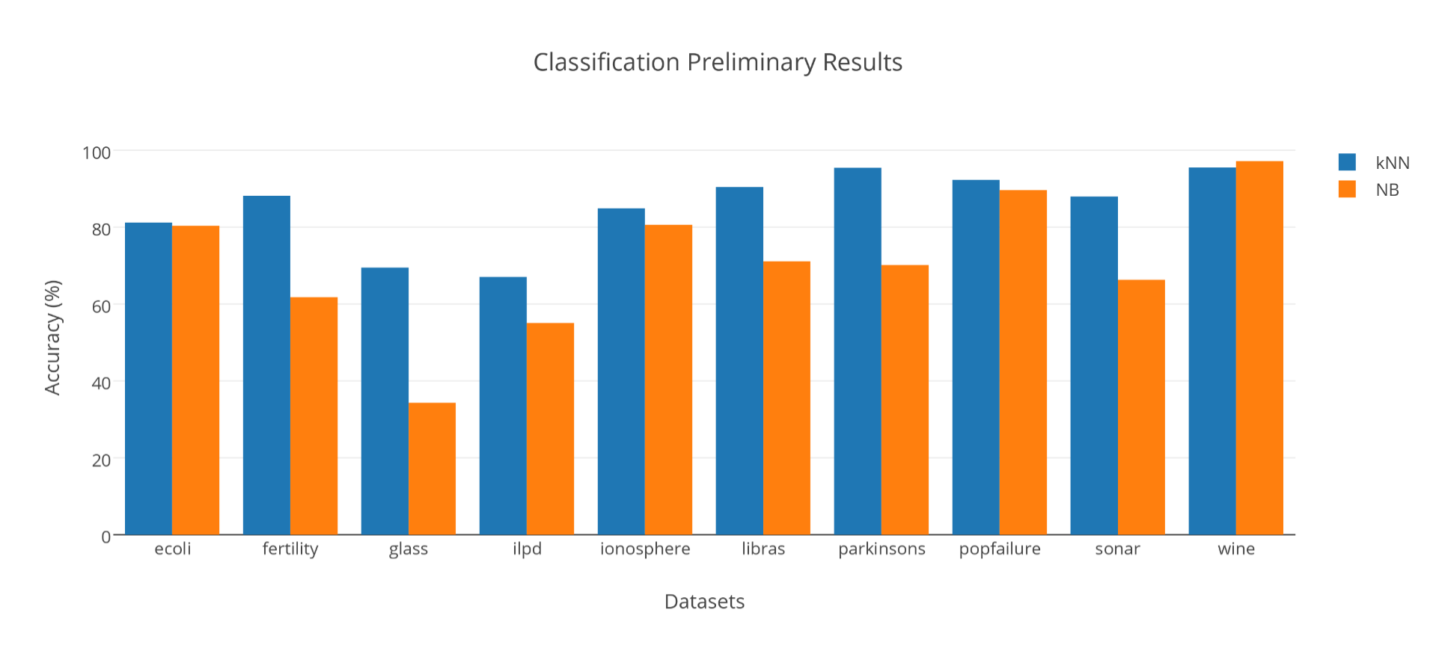
CLASSIFICATION PRELIMINARY RESULT GRAPH

Slide 7
REGRESSION PRELIMINARY RESULT
DATA | KNN ERROR (%) | NB ERROR (%)
airfoil.csv | 4.26 | 6.26
ERA.csv | 1.68 | 1.88
ESL.csv | 0.55 | 0.63
LEV.csv | 0.65 | 0.83
slump.csv | 4.6 | 7.66
student.csv | 1.85 | 1.23
wdbc.csv | 0.01 | 0.02
yacht.csv | 9.35 | 17.1
glass.csv | 1.02 | 1.79
ilpd.csv | 0.44 | 0.46

Slide 8
NEXT STEPS
Challenges:
NB for classification using numerical data
Gaussian estimate
Future Tasks:
NB for regression
Methods for NB improvements

Slide 9
QUESTIONS???

